Slide 1
Medieval Japan Teacher Institute
Images with Notes

Slide 2
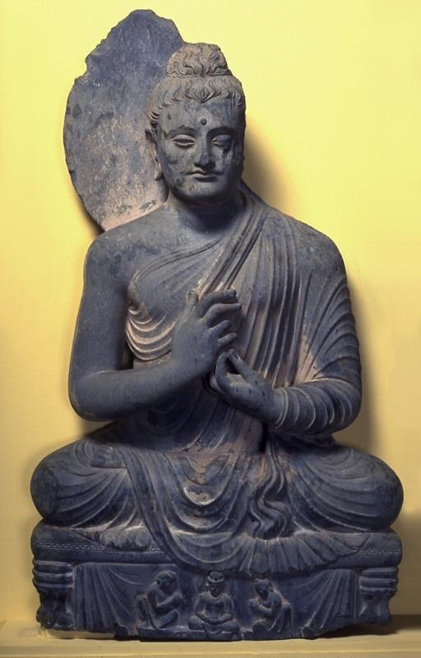
Seated Buddha Amitabha. Northern Pakistan (Gandharan Region). 300-500. Schist. Asian Art Museum, the Avery Brundage Collection, B60S393.
*
2
Notes:
The Buddha's hands are held in a gesture of preaching known as "turning the wheel of the doctrine." Beneath his low throne appears a seated princely figure flanked by kneeling devotees who may represent donors. Subsidiary scenes appear regularly on the bases of Gandharan Buddha sculptures. Those that are most similar to this example depict gods urging the Buddha-to-be to start his quest for enlightenment. According to various texts, the intervention of the gods may have occurred on two occasions: when the Buddha-to-be was awaiting his last rebirth and again just before he decided to renounce his princely life. On several image bases, pious donors appear in place of the gods.
Asian Art Museum Online Collection. 2012. Asian Art Museum. 20 Jul. 2012 <http://67.52.109.59:8080/emuseum/>.

Slide 3
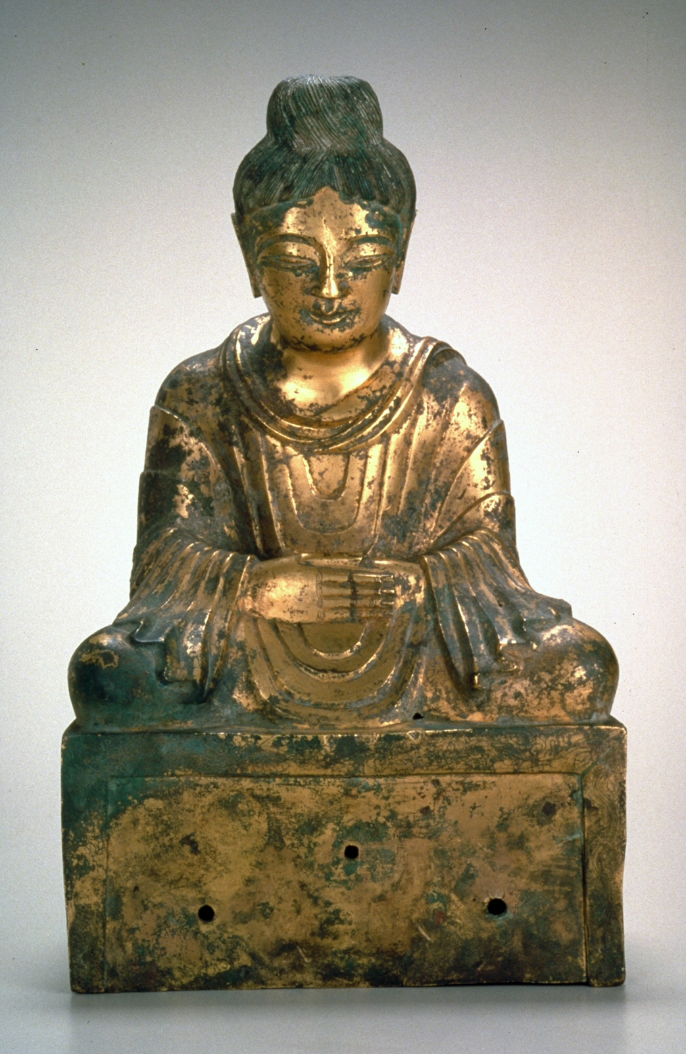
Seated Buddha, 338. Gilded bronze. China. Asian Art Museum, The Avery Brundage Collection, B60B1034.
*
3
Notes:
The fragmentary inscription on the back of the base dates this sculpture to 338, making it the earliest known dated Chinese Buddha image. It comes from the Later Zhao, a state in north China ruled by the Jie, a non-Chinese people, from 329 to 350. In addition to being practitioners of Buddhism, Jie rulers used the influence of Central Asian Buddhists and their Chinese disciples to bolster their rule.
Stylistically this figure belongs to a group influenced by Buddhist sculptures of Gandhara, in what is now part of India, Pakistan and Afghanistan, made from the beginnings of the common era to the 400s. Sculptures in this style were created in China between 300 and the 400s. Most surviving examples are small gilt bronze Buddhas. The relatively large scale and inscription on this piece are both indications of the high rank of the patron. Scholars theorize that the models for such pieces were small examples actually carried across the Silk Road. [M. Knight 12/2000]
The Late Zhao State
The fragmentary inscription on the back of the base attributes this sculpture to the Late Zhao, a small state founded by the Jie, a non–Han Chinese people from Central Asia who controlled China’s Central Plain during the fourth century. The state’s rulers regarded the Indian monk Fotudeng as their principal religious counsel and military adviser in the campaigns they undertook to extend their territory and authority.
Fotudeng had settled in the Central Plain in 310, preaching the Buddhist faith and seeking converts. He inspired Shi Hu, the third king of the Late Zhao, which may have prompted the ruler to commission this dignified statue. In 338, Shi Hu captured more than forty cities in the Central Plain. This Buddha was produced the same year, likely because the king believed it was a miraculous and venerated image, and worshiped it for blessings of victory.
Gilding Technique
Since gold was scarce and expensive in ancient China, it was often imitated with bronze thinly coated in gold, which also gave the metal greater resistance to tarnishing. This Buddha was cast to create a lustrous appearance using that particular strategy—gilded bronze. During the fourth century this highly costly technique was often used for small luxurious icons. The entire gilding over this large Buddha, much of which has been preserved, made the sculpture one of the most accomplished of that time.
The Chinese use of gold on bronze goes back more than two thousand years and was applied using a technique known as “mercury gilding.” The bronze is coated with a thick, melted liquid made primarily of mercury and gold, then heated by charcoal fire. The gilding is achieved by burnishing the liquid atop the surface so that it adheres without allowing air to permeate. Double-gilded pieces are more expensive than partial-gilt or plain metalware.

Slide 4
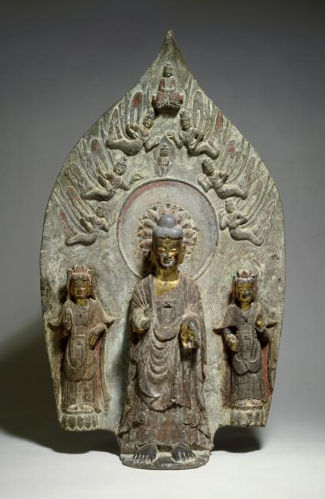
Stele of a standing buddha with two bodhisattvas. China. Eastern Wei dynasty (534-550). Limestone with polychrome decoration. Avery Brundange Collection, B60S112+
60S568
Notes:
Place of Origin: China
Buddhism's Arrival in China
There is no indication of other layers of color under the gilding and pigments on this stele (plaque with relief carving), and it is possible that they are original sixth-century colors. Many stone Buddhist sculptures were brightly colored, as were the buildings in which they were displayed.
The development of Buddhism in China during the four centuries following the collapse of the Han dynasty in 220 is a momentous chapter in the story of China's religious and cultural development. At the end of the Han dynasty, China already had a two-thousand-year history, during which it had developed a strong centralized civilization suspicious of and often condescending to things foreign. Moreover, China had a strong state cult and entrenched beliefs in ancestor worship.
Why, then, did so many Chinese convert to a religion that was being spread by missionaries from India? The reasons are complex and must often have been very personal. Four fundamental reasons can readily be suggested: the widespread suffering that followed the collapse of the mighty Han dynasty, the resulting doubts in the institutions of Han culture, the appeal of new and different ideas, and the occupation of large parts of China by non-Chinese people. While compatible with some existing spiritual ideas, Buddhism offered an end to life's cycle of suffering and offered rebirth in paradise. In contrast with other religions practiced in China at that time, it offered salvation to all levels of society.

Slide 5
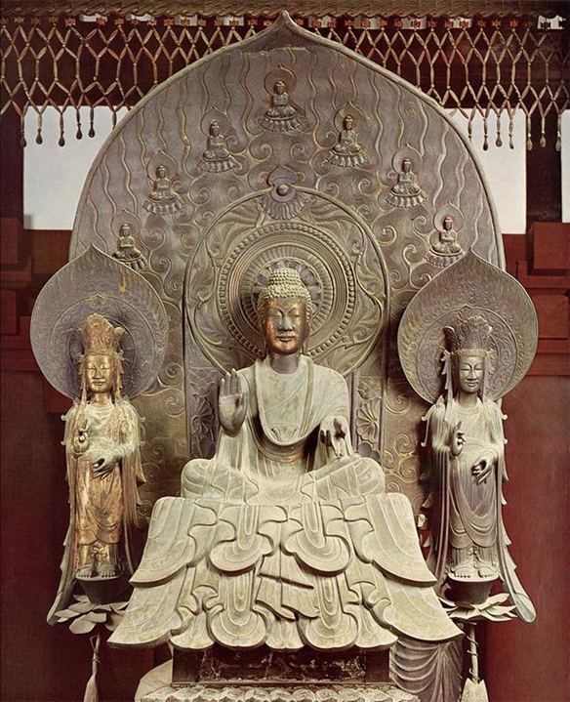
Title: Sculpture of Shaka Triad at the Horyuji
Date: 7th century
Location: Japan
Material: bronze
Measurements: 69.68503937 in. high
Collection: The John C. and Susan L. Huntington Archive of Buddhist and Related Art
Notes:
Shakya Triad
Creator: Tori Busshi
Title: Sculpture of Shaka Triad at the Horyuji
Title: sculpture of Sakyamuni Buddha Triad at the Horyuji
Title: Shaka triad
Date: 7th century
Location: Japan
Location: Nara
Location: Nara
Location: Kinki
Material: bronze
Measurements: 69.68503937 in. high
Style Period: Asuka
Description: Kondo (Golden Hall), interior, front, overview
Description: Sakyamuni Buddha triad
Collection: The John C. and Susan L. Huntington Archive of Buddhist and Related Art
Source: Data From: The John C. and Susan L. Huntington Archive of Buddhist and Related Art, The Ohio State University
The Shakya Triad is a statue of Gautama Buddha, flanked by Bhaisajyaguru to right right and Amitabha to his left. The inscription states that it was made to be a replica of Prince Shotoku, and the two attendants represent the Prince’s wife and mother. The statue was created as a prayer for the Prince’s journey into Pure Land after his death in 622.
This piece is commonly referred to as Tori Busshi’s masterpiece. It is made of bronze, currently residing in the Kondo of Horyu-ji, which is said to be one of the oldest wooden buildings in the world.

Slide 6
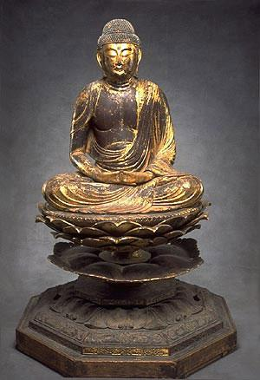
Seated Buddha Amitabha (Japanese: Amida). Japan. Heian period (794–1185). Lacquer and gold on wood. The Avery Brundage Collection, B60S10+.
*
6
Notes:
Amida, lord of the Western Paradise, is seated in deep concentration with half-closed eyes and hands held in the gesture of meditation. During the eleventh and twelfth centuries, images like this were created in large numbers as a direct result of the popularity of Pure Land Buddhism in Japan. This teaching instructed believers about the horrors of Buddhist hell and celebrated the glories of the Western Paradise, which can be attained through meditation and recitation of Amida's name.This Amida figure is made in a technique called "multiple blocks," which is described on the nearby panel entitled "Making of Buddhist Sculpture."
This 12th-century carved-wood figure is Amitabha, in Japanese, Amida. Loving giver of comfort and hope, Amida is the one of the most benevolent forms of the Buddha, who vowed to deliver the faithful to his pure land.He sits cross-legged on a lotus pedestal, in deep concentration. His eyes are half closed, and his hands are in the gesture of meditation. Amida's simple monk's robe drapes in gentle folds over his left shoulder and his lower body and legs. The flowing curving lines keep the viewer's eye moving over the surface, even as the calm facial features and the symmetrical triangular composition convey a feeling of serenity and stability.
Many images of Amida were made in Japan during the 11th and 12th centuries-as a direct result of the popularity of Pure Land Buddhism, which celebrates the glories of the Western Paradise, the Land of Bliss attainable through meditation and recitation of Amida's name. In ritual practice, Amida statues like this one were housed in temple complexes, or in Image Halls dedicated to him. Toward the end of the Heian period, elaborate memorial services were held for the deceased, and New Year's services were conducted to assure their re-birth in Amida's Western Paradise.The posture of meditation shown on this Amida figure is also used by later practitioners of Zen Buddhism, which became prominent in Japan over 500 years ago. It focuses on the individual and his or her own effort to attain enlightenment. The heart of Zen monasticism is the practice of meditation, the feature that is well known among Zen practitioners in the West.
Asian Art Museum Online Collection. 2012. Asian Art Museum. 20 Jul. 2012 <http://67.52.109.59:8080/emuseum/>.
Buddhism is a religion based on the teachings of a historical figure known as the Buddha Shakyamuni, who lived about 2,500 years ago. In some schools of Buddhism the Buddha Shakyamuni is thought of as one buddha among many, each inhabiting a different era or part of the universe. This sculpture shows Amitabha, identified as the Buddha of the Western Paradise. Amitabha is shown seated in deep concentration with half-closed eyes and hands held together at the lap in the gesture of meditation. He wears a simple monk’s robe, draped over the shoulders, leaving the flesh of his chest and the lower part of one arm exposed. His hair arrangement, typical for Amitabha, is composed of hundreds of curls, and raised at the top in a cranial bulge that is one of the marks of the Buddha’s supernatural powers.
During the eleventh and twelfth centuries, images of Amitabha were created in large numbers as a result of the popularity of a Buddhist sect known as Pure Land. The teachings of this sect emphasized the horrors of Buddhist hells and celebrated the glories of Amitabha’s Western Paradise, also known as the Pure Land. Pure Land adherents believed that if they uttered Amitabha’s name sincerely, they would achieve salvation, and be escorted to his glorious paradise after death by a retinue of gods.
The Amitabha is carved of wood and constructed using the “joined-wood” technique. In contrast to earlier wood sculpture carved from a single block, eleventh century sculptors developed this new technique to produce large, lightweight images. Artisans made images like this one by shaping and hollowing separate, smaller blocks of wood, then assembling the parts into one large sculpture.
There were several advantages to this technique: the finished sculpture was less likely to split because the wood core had been removed; the use of small pieces of wood required only a third of the wood needed for single-block construction; and the work could be divided into specialized steps each done by different groups of workers, a process somewhat akin to a factory assembly line. After completion, the figure was coated with lacquer and then gilded.
During the Kamakura period (1185–1333), proselytizing, mendicant monks spread the teachings of Pure Land Buddhism throughout Japan. Along with many commoners, warriors turned to faith in Amitabha as an expedient means of ensuring salvation. Although large-scale images like this one would not have been available on the battlefield, prayer strips inscribed with the name of Amitabha were distributed as portable reminders of his power, allaying the fears of many soldiers in combat. Pure Land monks are known to have attended warriors on the battlefield, encouraging prayer and witnessing the proper conduct of their death.
Asian Art Museum. Arts of the Samurai. San Francisco: Asian Art Museum, 2009.

Slide 7
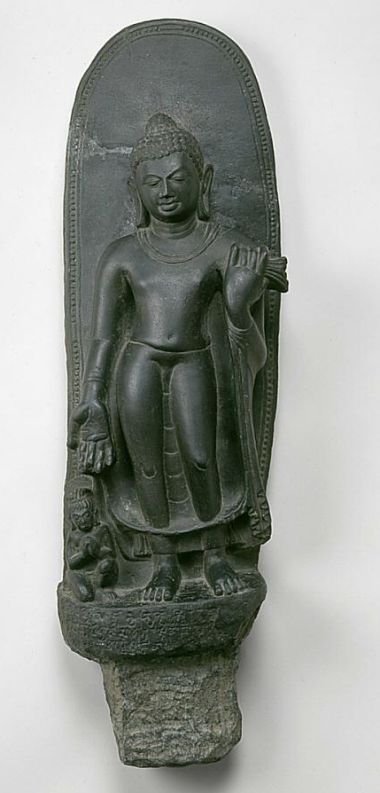
Standing Buddha with devotee, 500-700
India; Sultanganj, Bihar state
Chlorite
The Avery Brundage Collection, B60S571
Notes:
Standing Buddha with devotee, 500-700
India; Sultanganj, Bihar state
Chlorite
The Avery Brundage Collection, B60S571
This image was unearthed in 1861 or 1862, during construction of the East Indian Railway. Buried with it was the largest bronze Buddha statue ever found in India. Seldom do we know exactly where an artwork comes from, and this instance is a welcome exception.
On the back of this image is an incised drawing of a stupa (see the nearby case of miniature stupas), beneath which is the so-called Buddhist creed: The Buddha has explained the cause of all things that arise from a cause. He, the great monk, has also explained their cessation.
On the front of the sculpture's base is a dedicatory inscription: This is the pious gift of the monk [name unclear] for the attainment of supreme knowledge by his father and teachers and all living beings. (Based on a translation by W. Zwalf)
This image has been placed between two galleries because it documents the contribution of fifth-century northern-central Indian styles to the development of the characteristic eastern Indian styles seen in the next gallery.

Slide 8
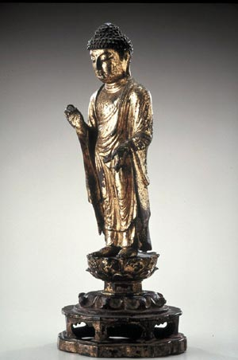
STANDING BUDDHA, APPROX. 700-800, KOREA, UNIFIED SILLA DYNASTY (668-935), GILT BRONZE
Notes:
Small gold and gilt bronze Buddha and Bodhisattva images have been discovered in pagodas as well as at temple sites, indicating that they were made not only for family altars and private worship but also for specific purposes such as to pray for the eternal rest of a ruler or a famous monk. Buddhist images created during the 700s were full-bodied and more realistic than earlier versions, suggesting that there was an active cultural exchange with Tang China.
Images like this eighth-century gilt-bronze Buddha from Korea encourage believers to approach and invoke his compassion and assistance. The Buddha stands on a double-lotus pedestal; his ample robes cascade down in what's called a "wave pattern." His eyes look down; his expression is calm and meditative. He holds his hands in the gestures used most often in early Korean Buddhist images-the right one signifies dispelling fear; the left one, gift-granting.
Small gold and gilt bronze Buddhas like this one were often placed on altars at home or in private chapels, for private and family worship. They were also placed in pagodas, as offerings for the well-being of the living and also for the eternal rest of family members or monks.
Buddhism was introduced into Korea from China in 372, and was officially accepted by all three of the Korean Kingdoms by the middle of the 500s. The Buddhist images you see here were made in the 7th and 8th centuries, during the Three Kingdoms period and the Unified Silla dynasty. After defeating neighboring kingdoms, this dynasty launched a vigorous policy, which used Buddhism to strengthen the newly enlarged state. It became a great Buddhist nation, establishing contacts with China, Japan, India, and West Asia. The capital city of Gyeongju has been described as a place where the roof lines of Buddhist temples were lined up like a formation of flying geese, and the pagodas were as numerous as the stars.

Slide 9
Standing Amitabha Buddha (Amida Nyorai), approx. 1100–1185. Japan. Gilding and lacquer on wood with rock crystal inlay. Asian Art Museum, The Avery Brundage Collection, B60S338. Photograph © Asian Art Museum.
Notes:
Standing Amitabha Buddha (Amida Nyorai), approx. 1100–1185. Japan. Gilding and lacquer on wood with rock crystal inlay. Asian Art Museum, The Avery Brundage Collection, B60S338. Photograph © Asian Art Museum.
Amida, lord of the Western Paradise, wears a monk’s robe and stands in concentration with eyes half-closed. His palms face outward with the tips of both index fingers and thumbs touching. In Japan this particular
hand gesture signifies Amida’s descent to the earth to welcome the souls of the deceased to his paradise, as the Pure Land school of Buddhism teaches. Pure Land Buddhism was popular during and after the
twelfth century, and many paintings and sculptures of Amida were created in this tradition. Per Iwata Shigeki, Nara National Museum, this was made around the year 1150. when there were many of these kinds of sculptures produced. They can be found in temples all over Japan. Probably very lightweight and made relatively quickly for a ritual or special event (may have been made in as little as a week.) (M. Rinne 2-4-2013)

