Slide 1
Political Art and the Japanese Internment Experience

Slide 2
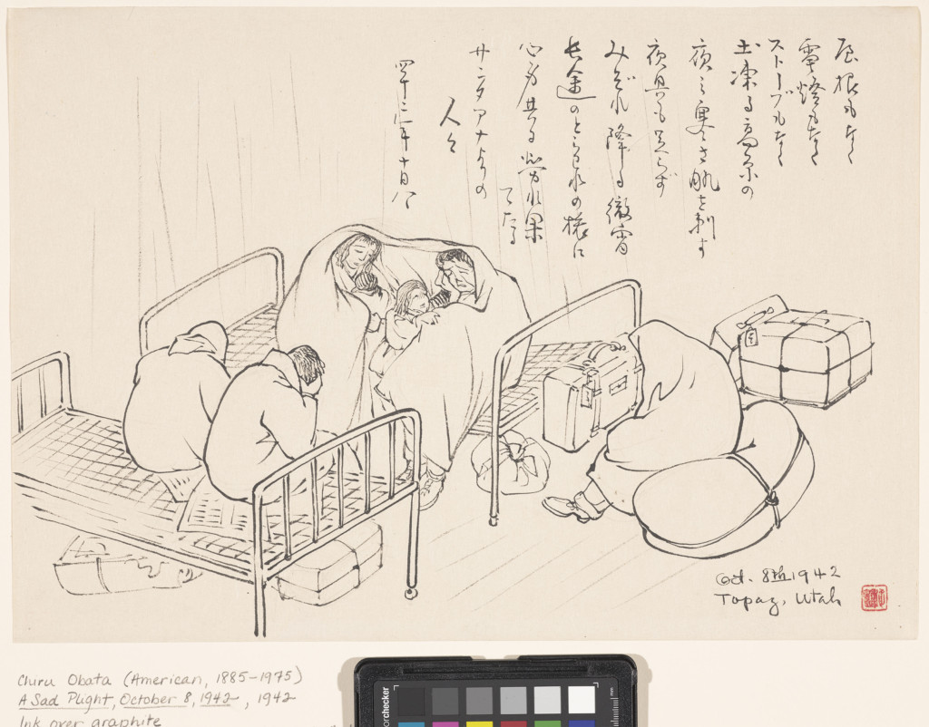
A Sad Plight, October 8, 1942 Chiura Obata (American, b. Japan, 1885–1975), ink over graphite on paper,, Fine Arts Museums of San Francisco, Museum purchase, gift of the Graphic Arts Council, 2001.28.3

Slide 3
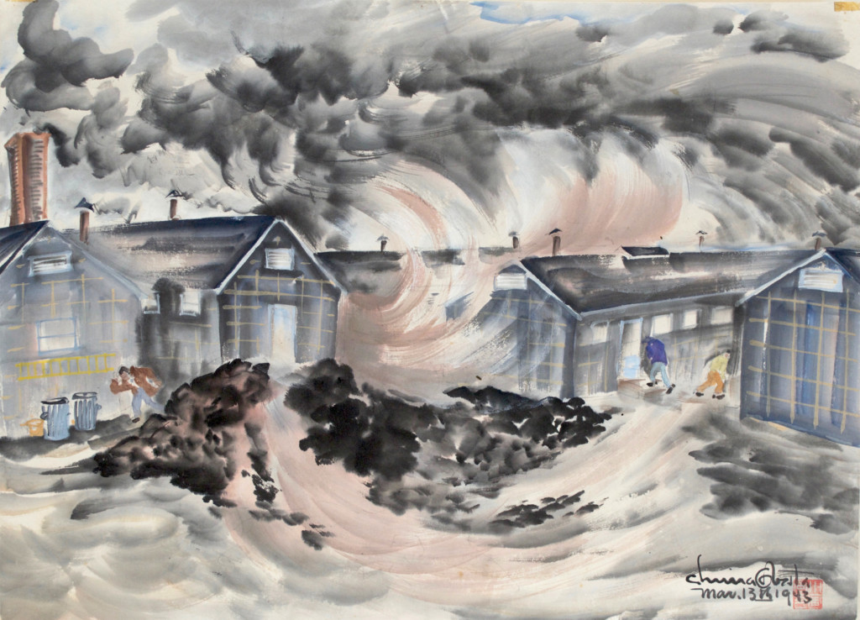
Dust Storm, Topaz, March 13, 1943, Chiura Obata (American, b. Japan, 1885–1975), watercolor on paper. Private collection.

Slide 4
Silent Moonlight at Tanforan Relocation Center, 1942 Chiura Obata (American, b. Japan, 1885–1975. Private collection.

Slide 5
A watercolor depicting the Heart Mountain Relocation Center in Wyoming. Estelle Peck Ishigo. Photo Credit Rago Arts & Auction Center.

Slide 6
Waiting in Lines at Tanforan Assembly Center, San Bruno, California, 1942. Mine Okubo. Drawing. Japanese American National Museum, Gift of Mine Okubo Estate, 2007.62.
Citizen 13660, Mine Okubo, 1946. Drawing. Courtesy of Mine Okubo/University of Washington Press Illustration

Slide 7
Mother and Children -- Crying Baby. Miné Okubo, Curtesy of the Topaz Museum, Delta, Utah

