Slide 1
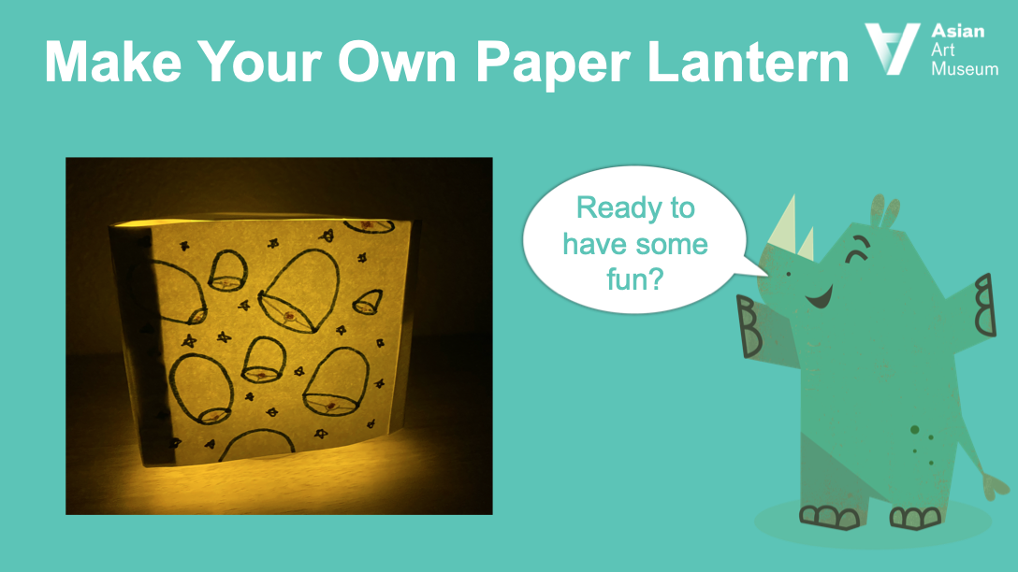

Slide 2



The Girl Who Used Her Wits
In the story called “The Girl Who Used Her Wits” (also known as “The Clever Daughter-in-Law”), two sisters are tasked to find fire wrapped in paper and are stumped. Luckily, on their journey to visit their mother, they meet
a clever girl who solves the riddle and gives them fire wrapped in paper – a lantern!
I love stories,
don’t you?

Slide 3

Objectives
Like the clever girl, create your own paper lantern.
Retell the Chinese folktale to your friends.
Celebrate the Spring Lantern Festival.
(the 15th day of the first month of the lunar calendar, or the last day of the Lunar New Year Festival)
Celebrate the Mid-Autumn Festival.
(the 15th day of the 8th month of the lunar calendar with a full moon at night)

Slide 4
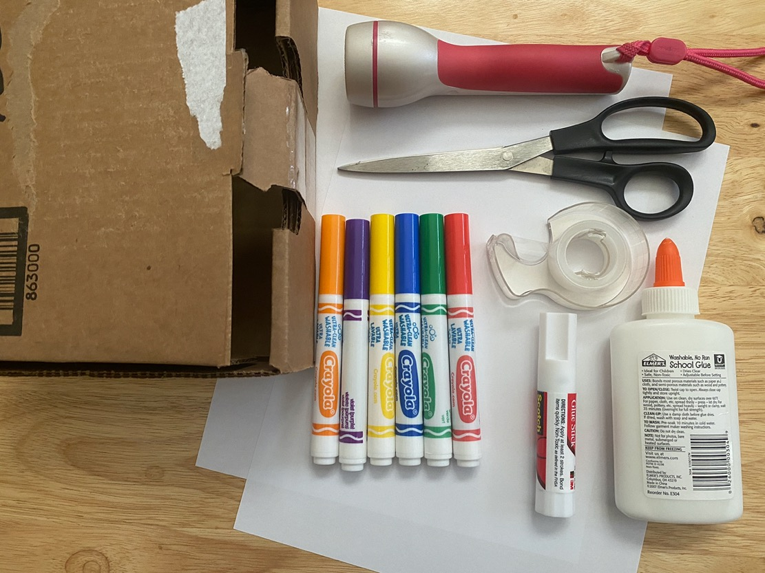

Gather your materials
You will need the following:
Two blank pieces of 8 ½-by-11-inch paper
Safety scissors
Cardboard box
Color markers
Glue or tape
Flashlight or flameless candle

Slide 5
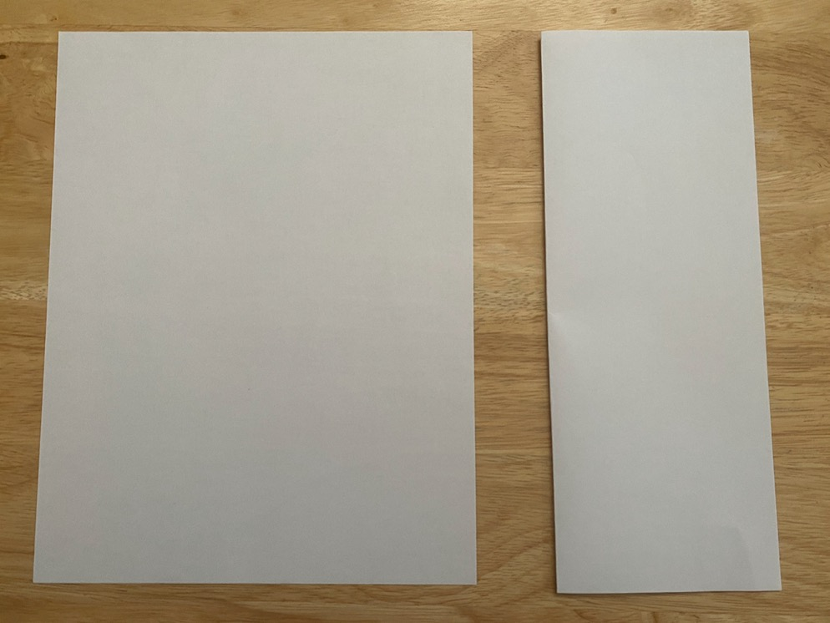
Directions
1
Fold one piece of paper in half lengthwise. Unfold.

Slide 6
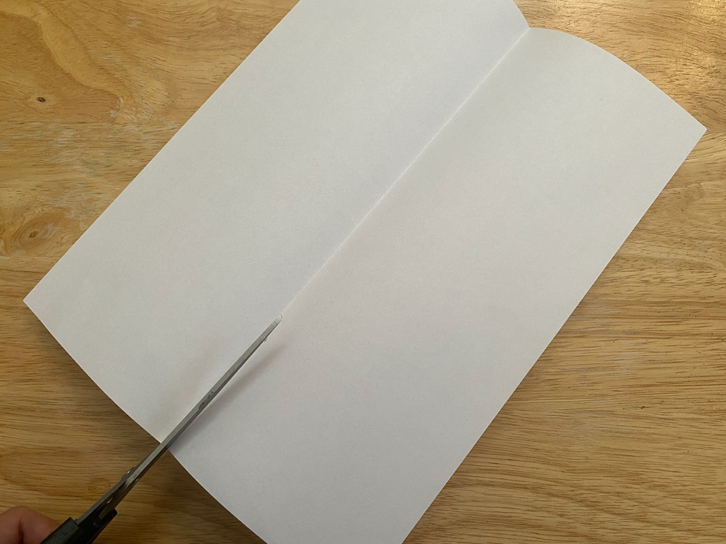
Directions
2
Along the folded line, cut the paper in half.

Slide 7
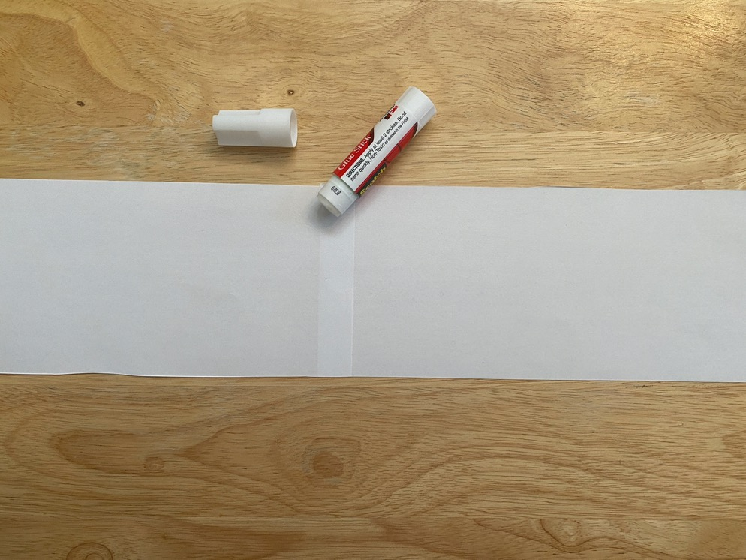
Directions
3
Glue the two halves together to create one long strip of paper.

Slide 8
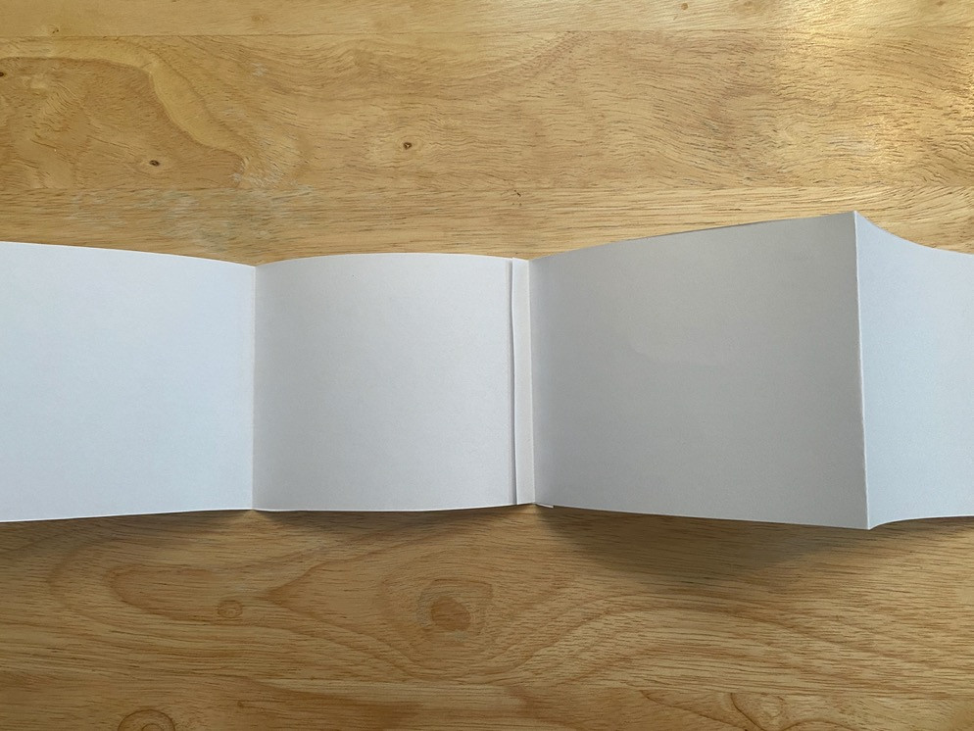
Directions
4
Fold the paper into four equal parts; these will be the four sides of your lantern.

Slide 9
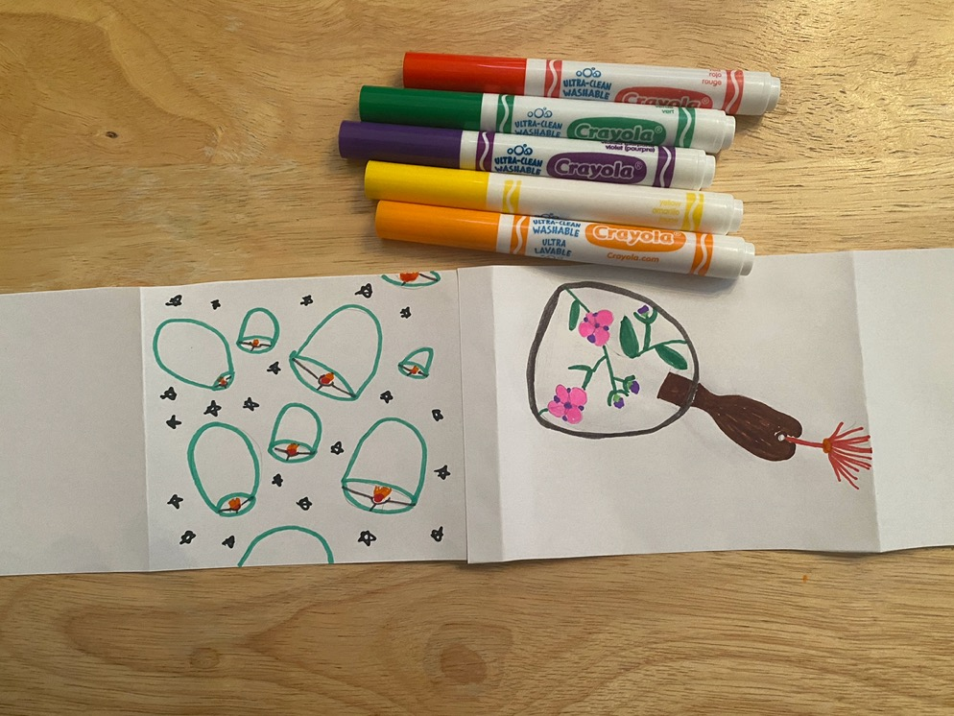
Directions
5
Decorate each square. Designs could include scenes or objects from the story.

Slide 10
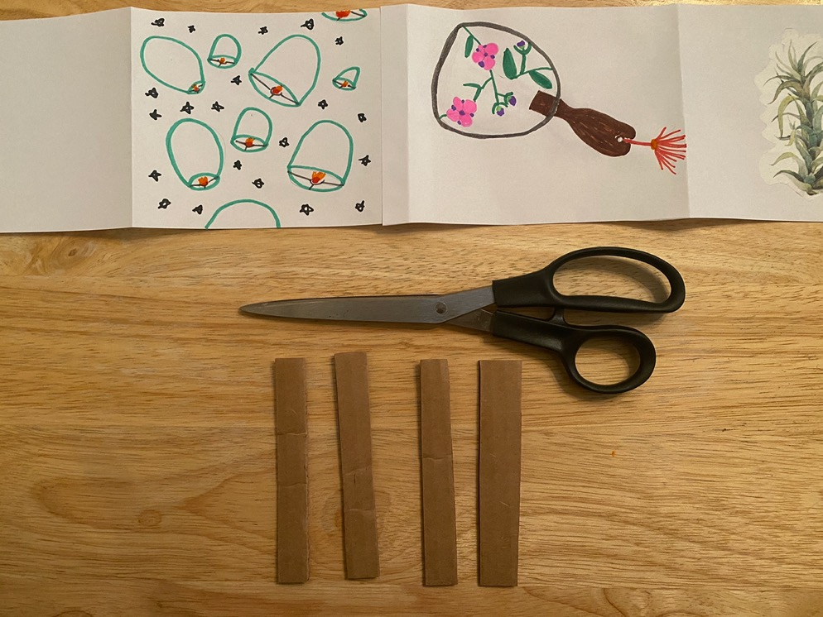
Directions
6
Cut four pieces of cardboard. The width should be about half an inch, and the length should be the height of the folded paper.

Slide 11
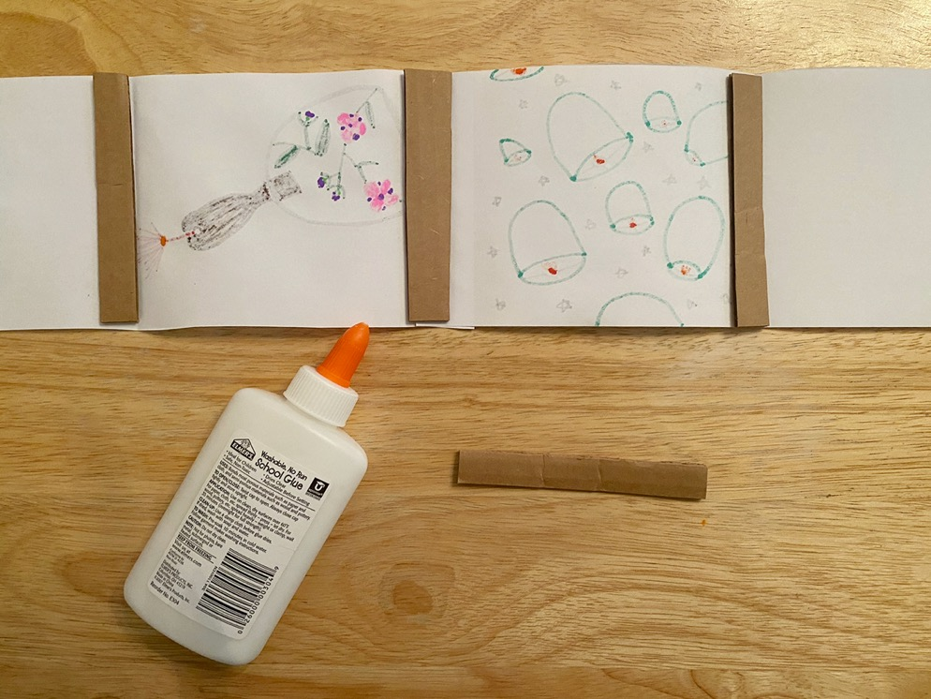
Directions
7
Glue three of the cardboard pieces along the folds of the paper.

Slide 12
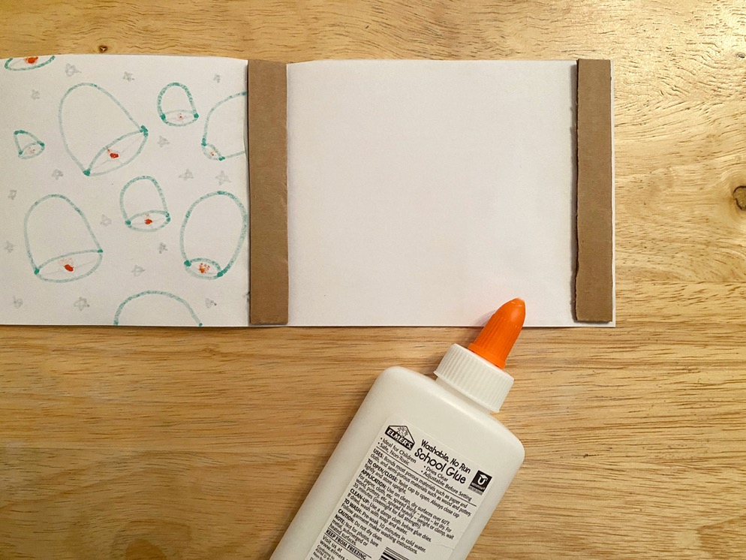
Directions
8
Glue the fourth cardboard piece at one end of the paper.

Slide 13
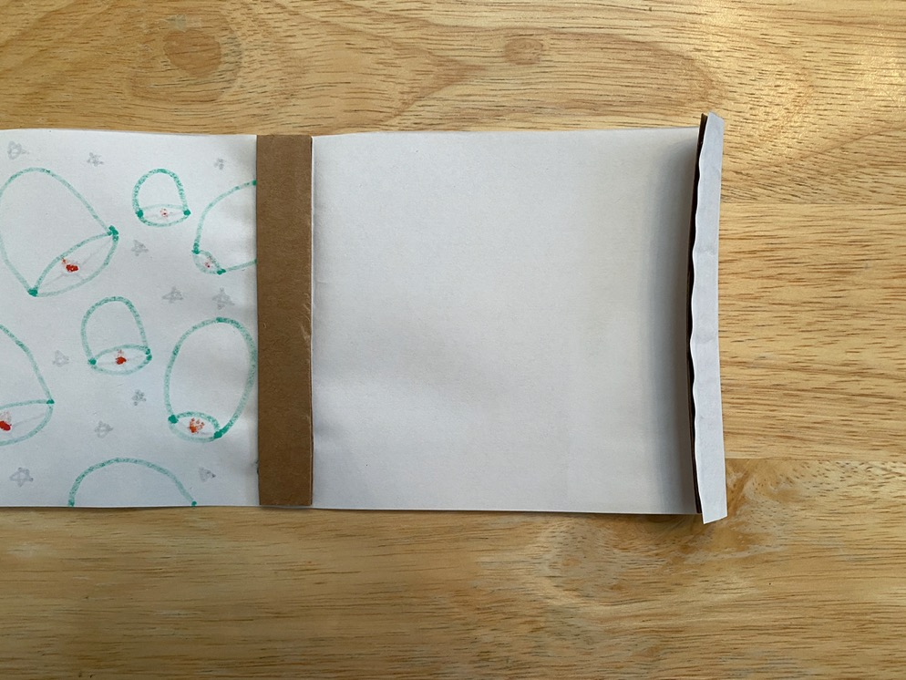
Directions
9
Fold the paper over the fourth cardboard piece at the end. Unfold. This fold will overlap the other end of the paper strip.

Slide 14
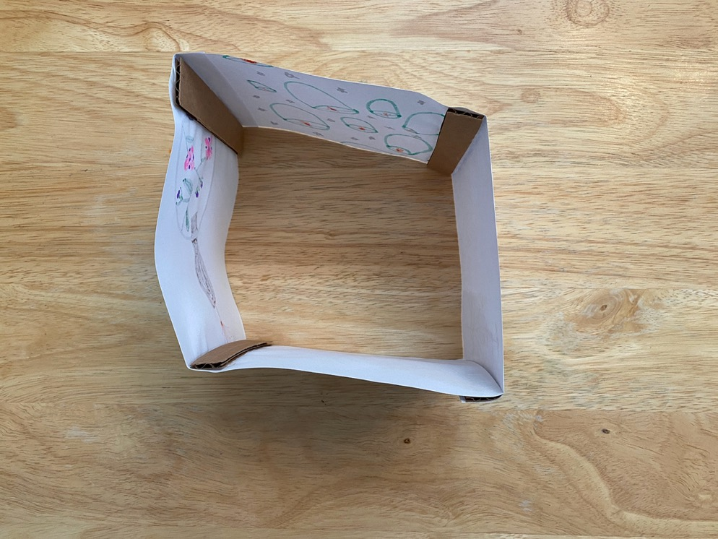
Directions
10
Glue the ends of the paper together to create a cube.

Slide 15
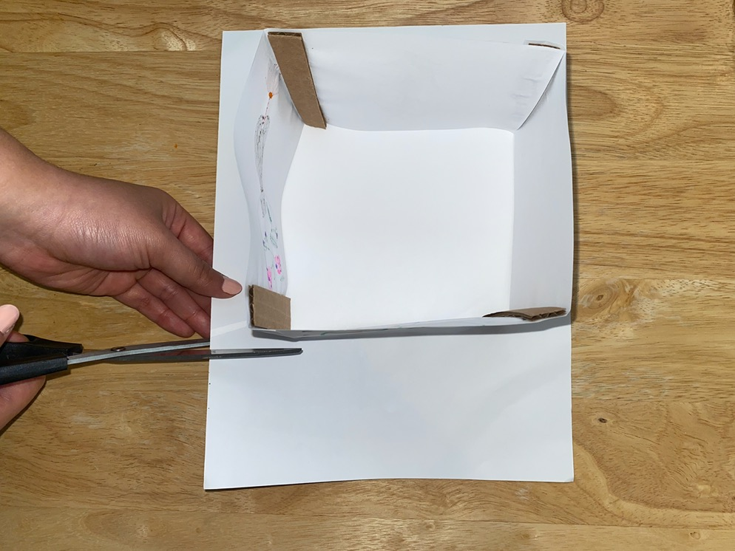
Directions
11
Trace the top of the cube on the other piece of paper and cut along your tracing. This will be the top of your lantern.

Slide 16
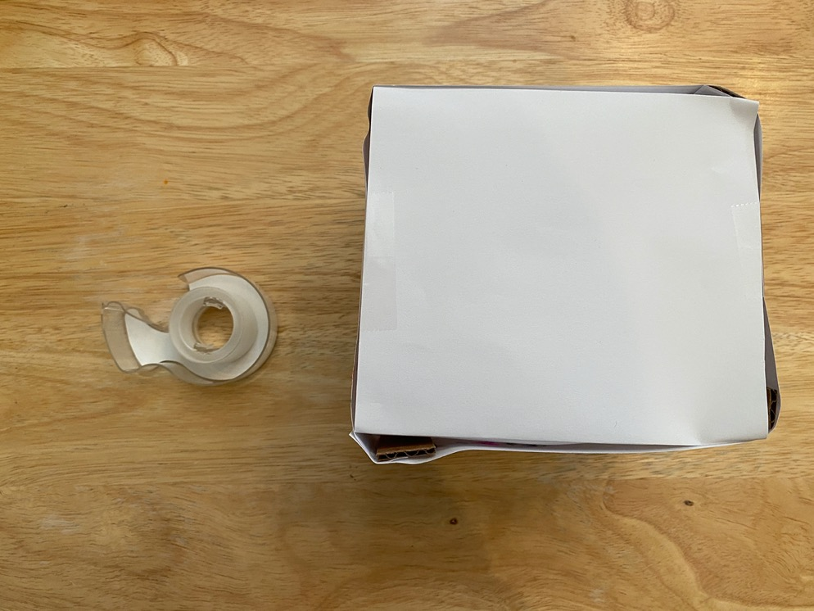
Directions
12
Attach the top of the lantern to the cube.

Slide 17
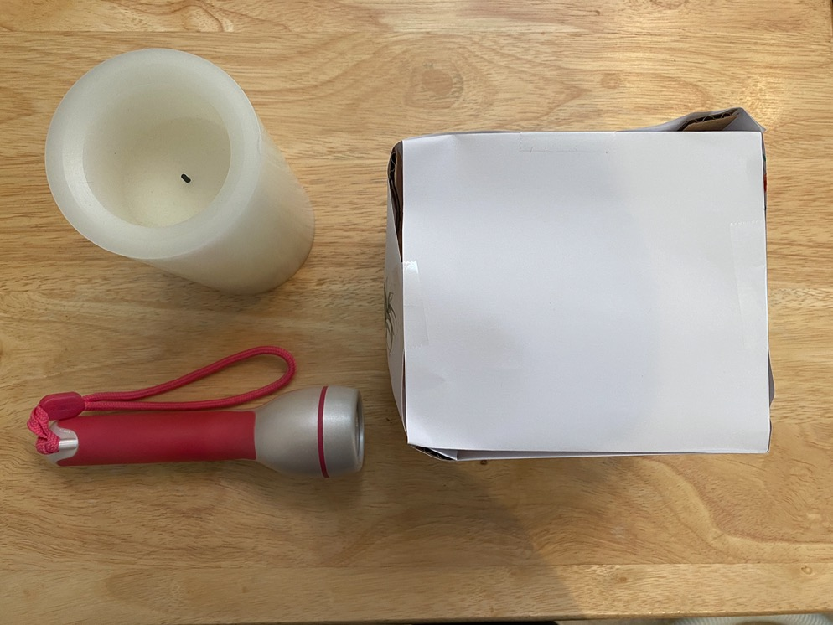
Directions
13
Place a flashlight or flameless candle under your paper lantern to simulate a fire.

Slide 18
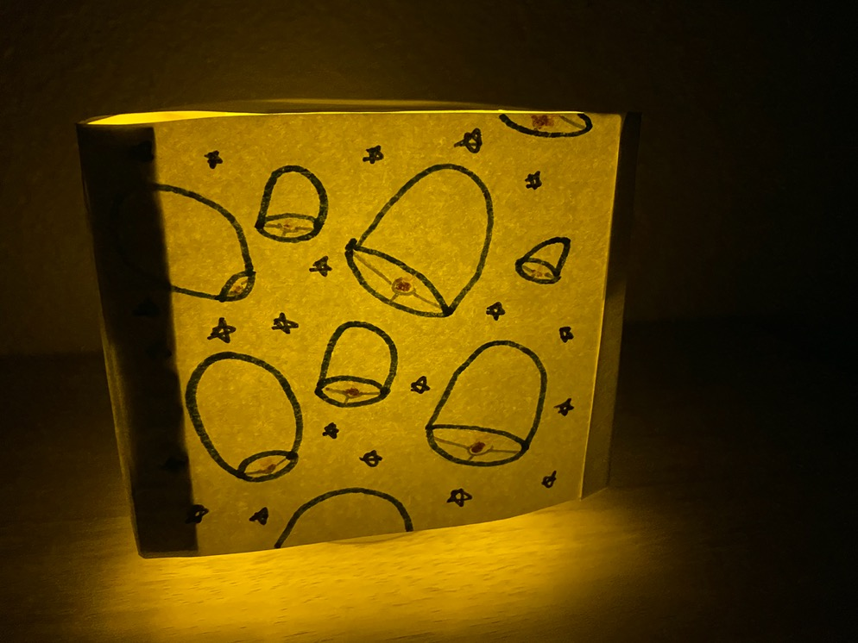
Directions
14
Now, retell the story with your new prop!

Slide 19
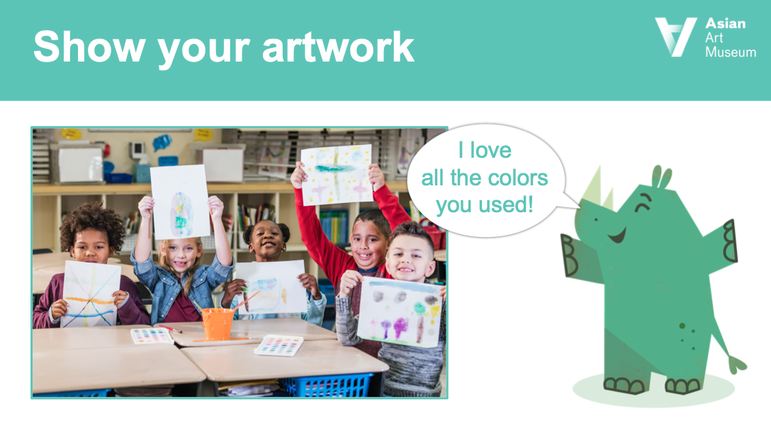

Slide 20

Share your work!
And see what other students have posted.
Stories from China Art Projects:
https://padlet.com/aamschoolprograms/StoriesfromChina
Heroes and She-roes Art Projects:
https://padlet.com/aamschoolprograms/HeroesandSheroes
Show me
your stuff!
Notes:
https://padlet.com/aamschoolprograms/StoriesfromChina
https://padlet.com/aamschoolprograms/HeroesandSheroes

Slide 21
